Slide 1


Spoke-Darts for High-Dimensional Blue-Noise Sampling
Scott A. Mitchell ACM TOG 37:2, May 2018 Scott A. Mitchell, Mohamed S. Ebeida, Muhammad A. Awad, Chonhyon Park, Anjul Patney, Ahmad A. Rushdi, Laura P. Swiler, Dinesh Manocha (now UMD), Li-Yi Wei

Slide 2
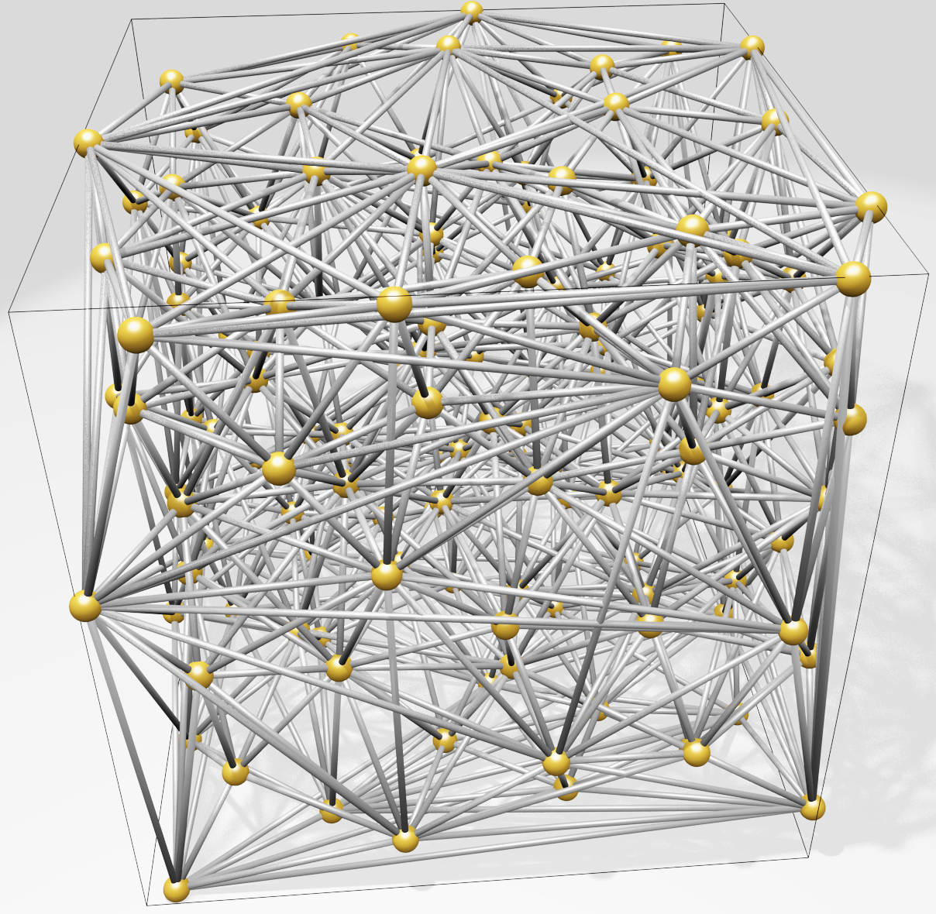
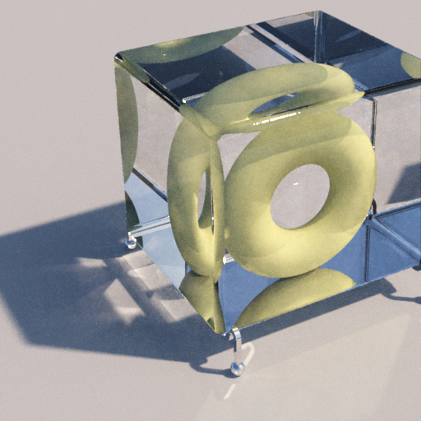
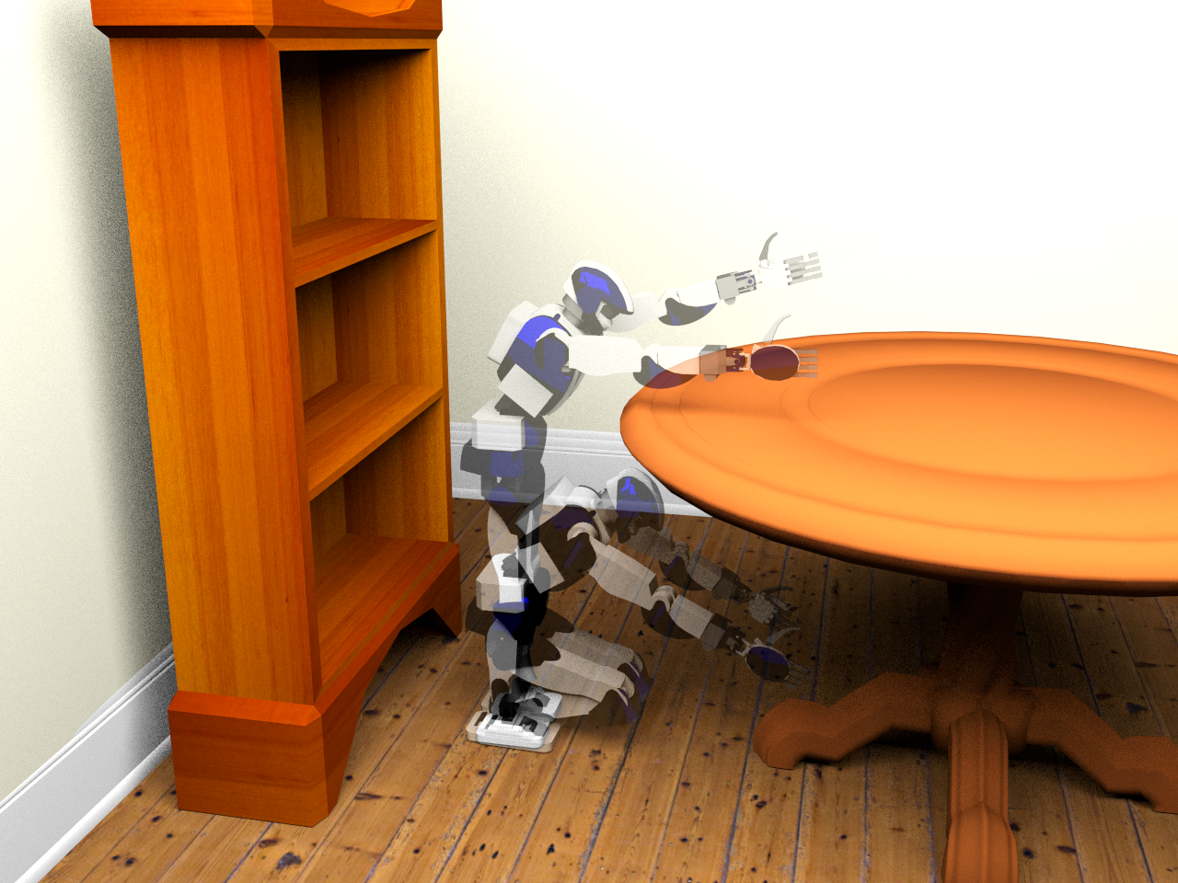
Motivation
High-dimensional blue-noise sampling is useful but hard to generate especially adaptively!
Render
Geometry
8-100D: approximate Delaunay Graphs (Voronoi neighbors)
8D: proof-of-concept path tracing
23D: find a path in robot configuration space
Motion Plan
Optimize
100D: adaptively explore black-box function to find global minimum

Slide 3
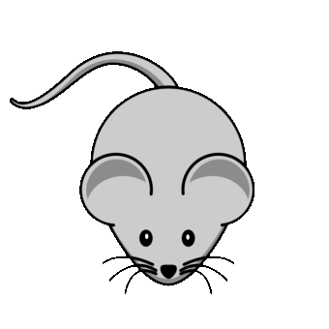

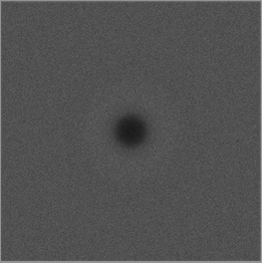
Motivation
Maximum
domain-to-sample distance
Goal: algorithm to produce point distributions
Requirements
Output: blue-noise, uniform-random point distribution except
No points too close
No big gaps
Process
Memory & time scales well to high dimensions (e.g. 20D)
Locally adaptive, general domain shapes
Confidence: provable guarantees on output quality
Minimum sample separation
RP Radial Power
RDF Radial Distance Function

Slide 4
What’s wrong with the algorithms we already have?
SimpleMPS guarantees saturation
runtime & memory
divide domain into cubes, diagonal length r while ∃cubes, and cube diagonal > machine precision do (A(d) × #cubes) times: pick a cube pick candidate sample from cube if distance(candidate, prior samples) > r accept candidate as sample discard cube refine remaining cubes
darts
refine
darts
refine
"SimpleMPS": A Simple Algorithm for Maximal Poisson-Disk Sampling in High Dimensions, Eurographics 2012

Slide 5
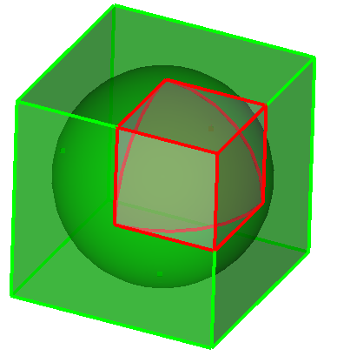
What’s wrong with the algorithms we already have?
SimpleMPS guarantees saturation … but doesn’t scale by dimension d ☹
runtime & memory
Problem: cube poorly approximates sphere Exponentially worse as dimension increases More empty boxes, memory limit d≈6
darts
…
refine
d=1
V(cube) = 1
V(sphere) = 1
d=2
V(cube) = 1
V(sphere) = 0.785…
d=3
V(cube) = 1
V(sphere) = 0.523…
d→∞
V(c) = 1
V(s) → 0
darts
Any algorithm that constructs (an approximation of) remaining sample space is doomed to be exponential-in-d
refine
"SimpleMPS": A Simple Algorithm for Maximal Poisson-Disk Sampling in High Dimensions, Eurographics 2012

Slide 6
What’s wrong with the algorithms we already have?
Bridson 2007 scales … but doesn’t guarantee saturation ☹
runtime & memory
Movie from fast-forward

Slide 7
Conclusions
Free software
SpokeDartsPublic on github: https://github.com/samitch/SpokeDartsPublic
Want high-d blue noise?
Use spoke-darts line sampling
Supports adaptive sampling over general domains
Nearly as easy to implement (especially since I already did that for you :) and runs faster, than Bridson 2007
Want blue-noise with better spectrum?
Use two-spokes variant
Takes longer
Open problems
Prove non-trivial saturation-bound on Bridson 2007?
Does saturation matter for high-d rendering, etc.?

